Slide 1


A Final Year Project Final Defense
On
Handwritten Digit Recognition Using Deep Learning
Presented By:
Biswas Poudyal(10526/073)
Krishna Khanal(10691/073)
Sameer Kattel(10713/073)
Subina Lama(10720/073)
December 31, 2020

Slide 2
Presentation Outline
About Project Topic
Literature Review
System Analysis
System Design
System Implementation
Testing
Conclusion

Slide 3
About Project Topic
Project Introduction
Handwritten Digit Recognition is the method of understanding handwritten digits to classify them as ten digits (0 to 9) by machines without human intervention.
The project uses Deep Learning approach (MLP architecture) to train model and classify the handwritten digits.
Problem Statement
Handwritten Digit Recognition, a challenge for computer
Orientations, Similarities, Extraction challenges, Translations of digits

Slide 4
About Project Topic
Objectives
To design a Multi-Layer Perceptron Model that recognizes Handwritten digits (one at a time).
To properly analyze and optimize the designed model to achieve higher performance and accuracy over 99%.
To implement data augmentation techniques to increase datasets for more accurate training and classification.
Project Scope
Widely used in the advancement of the automation process and improve the interaction between man and machine
Used to recognize other English alphabets, Devanagari numerals and characters using transfer learning

Slide 5
About Project Topic
Limitations
The system cannot recognize multiple digits in the same image or any Devanagari numerals.
Images with elastically distorted digits are still hard for the system to recognize with high precision.
The system cannot classify characters, letters or other images.
There are hardware resources’ limitations for training the model.

Slide 6
Literature Review
Classifier | Error Rate(%) | Reference
linear classifier (1-layer NN) | 12 | LeCun et al. 1998
K-NN with non-linear deformation (P2DHMDM) | 0.52 | Keysers et al. 2007
Virtual SVM, deg-9 poly, 2-pixel jittered | 0.56 | DeCoste and Scholkopf, 2002
2-layer NN, 800 HU, cross-entropy [elastic distortions] | 0.7 | Simard et al. 2003
6-layer NN 784-2500-2000-1500-1000-500-10 (on GPU) [elastic distortions] | 0.35 | Ciresan et al. 2010
Convolutional net Boosted LeNet-4, [distortions] | 0.7 | LeCun et al. 1998
Convolutional net With DropConnect | 0.21 | LeCun et al. ICML 2013
Branching/Merging CNN + Homogeneous Filter Capsules | 0.16 | A. Byerly et al. 2020
Table : Past Works in Handwritten Digit Recognition
Notes:
In 2003, a team of researchers led by Patrice Y. Simard were first to reduce the error rate below 1% using the Neural Network(NN) based model.
They used 2-layer NN and 800 Hidden Units(HU) with elastic distortion.
They used two simple cost function, MSE and Cross entropy each resulting in the error rate of 0.9% and 0.7% respectively. [2]
Hinton followed shortly using a 3-layer NN with 500+300 HU, softmax function, cross entropy loss function and weight decay to achieve error rate of 1.53%. [3]
The next record breaking performance using simply MLP was achieved by a team of researchers led by Dan Claudiu Ciresan in 2010.
His team used a 6-layer NN with elastic distortion and trained the model over GPU to achieve the error rate as low as 0.35%. [4]

Slide 7
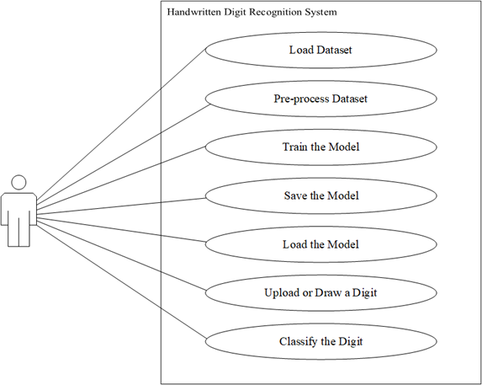
System Analysis: Functional Requirements
The model should be able to classify any new image of a handwritten digit with maximum accuracy.
The model should not classify any alphabets and characters as a digit.
Notes:
-describe what the model should and should not do.
-describes how the model should behave for a particular set of inputs.

Slide 8
System Analysis: Data Description
MNIST Database used.
The database consists of four files in binary(.idx) file format
Datasets are preprocessed and splitted into train, dev and test sets.
Dataset | Processed Array size | Original Array Size
Training Set Image | (784, 50000) | (50000, 28, 28)
Training Set Label | (10, 50000) | (1, 50000)
Dev Set Image | (784, 10000) | (10000, 28, 28)
Dev Set Label | (10, 10000) | (1, 10000)
Test Set Image | (784, 10000) | (10000, 28, 28)
Test Set Label | (10, 10000) | (1, 10000)

Slide 9
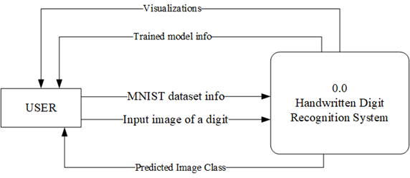
System Analysis: Process Modeling
Figure : Context Diagram of Handwritten Digit Recognition System
Notes:
-describe what the model should and should not do.
-describes how the model should behave for a particular set of inputs.

Slide 10
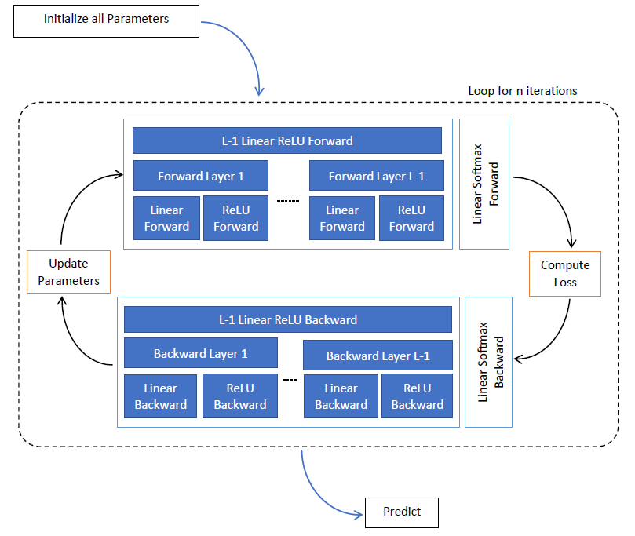
System Design: Architecture Design
Figure : Feed-forward Neural Network model(MLP)

Slide 11
System Design: Data Design
Datasets are adapted from the MNIST database.
Data labels values are from 0 to 9 and images file has pixels organized row-wise ranging values from 0 to 255.
These datasets are preprocessed before training. The training datasets are splitted into the training and development sets.
The datasets are flattened and then normalized.
The output labels of the data are transformed into one-hot encoding representation.

Slide 12
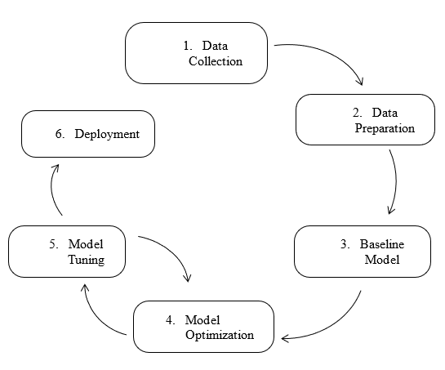
System Design: Process Design
Figure: CPMAI-based Process Model

Slide 13
System Design: Experiment Design
Baseline model
Initialization Selection
Optimization Selection
Regularizer Selection
Hyperparameter Tuning

Slide 14
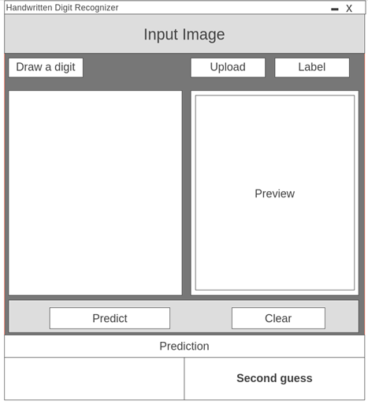
System Design: Interface Design
Figure: Wireframe for GUI for Prediction

Slide 15
System Implementation: Tools Used
Development Tools
Anaconda (v1.9.12)
Jupyter Notebook (v6.1.5)
Spyder (v4.1.5)
Python (v3.8.5)
Git (v2.17.1) and GitHub
B. Design Tools
MS Visio 16
MS Word 16
MS PowerPoint 16

Slide 16
System Implementation: Methodology
Data Collection
Data Preparation
Baseline Model
Model Optimization
Model Tuning
Deployment

Slide 17
System Implementation: Experiments
Initialization Selection
Regularizer Selection
Optimizer Selection
Hyperparameter Tuning
 | Training Accuracy | Validation Accuracy
Random Initialization | 82.46% | 82.44%
He-Initialization | 94.90% | 93.42%
 | Training Accuracy | Validation Accuracy
BGD | 61.12% | 60.52%
MGD | 97.03% | 95.46%
Adam | 99.28% | 96.26%
 | Training Accuracy | Validation Accuracy
L2 Regularizer | 93.07% | 92.24%
Dropout | 97.46% | 96.12%
Hyperparameters | Hidden Layers | Hidden Units | Learning Rate | Minibatch Size | Keep_props
Best value | 2 | [2916, 2884] | 0.000672 | 345 | 0.9

Slide 18
Testing: Unit Testing
Test Case 1 – Dataset Preparation Module Test
Test Case 2 – Dataset Augmentation Module Test
Test Case 3 – Utility Module Test
Test Case 4 – Neural Network Module Test
Test Case 5 – GUI Module Test
Test Case 6 – Training Module Test

Slide 19
Testing: Integration Testing
S.N. | Action | Input | Expected Output | Actual Output | Test Result
1 | Load Dataset | Dataset type, a sample size | Numpy array of training and dev set images and labels | Numpy array of training and dev set images and labels | Pass
2 | Prepare Dataset | Train, dev and test datasets | Flattened and normalized image and one-hot encoded labels | Flattened and normalized image and one-hot encoded labels | Pass
3 | Dataset generator | Training dataset, augmentation count, batch size | Generate and saves augmented training set | Number of augmented dataset files equal to the augmentation count | Pass
4 | Train model | Train and dev datasets, parameters, hyperparameters, optimizer, initialization, regularizer, and patience | A trained model with the best validation accuracy. Decreasing training loss and increasing training accuracy | A trained model with the best validation accuracy, Decreasing training loss and increasing training accuracy | Pass

Slide 20
Testing: System Testing
S.N. | Action | Input | Expected Output | Actual Output | Test Result
1 | Predict Uploaded image | Image of a handwritten digit (3), Click the ‘Predict’ button | The first prediction value as 3 | The first prediction value as 3 | Pass
2 | Predict drawn image | Image of a digit captured from the canvas (2), click ‘Predict’ button | The first prediction value as 2 | The first prediction value as 2 | Pass
3 | No image uploaded or drawn | Click the ‘Predict’ button | Message to upload or draw an image | Message to upload or draw an image | Pass
4 | Clear | Click the ‘Clear’ button | All preview and messages erased, canvas empty | All preview and messages erased, canvas empty | Pass

Slide 21
Conclusion: Final Results
Validation Accuracy: 99.07%
Test Accuracy: 99.16%
Unable to guess 84 out of 10000 images
Correct Second guesses 64 out of 84
Final Trained Model
Architecture | MLP
Hidden Layers | 2
Hidden Units | [2916, 2884]
Optimizer | Adam
Regularizer | Dropout
Data Augmentation | Affine
Datasets Generated | 2 Million per epochs
Training Epochs | 23
Table : Overall Project Conclusion

Slide 22
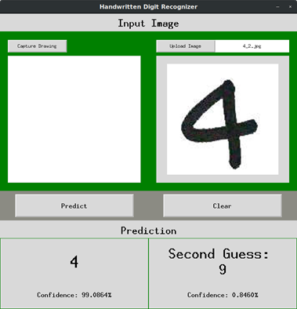
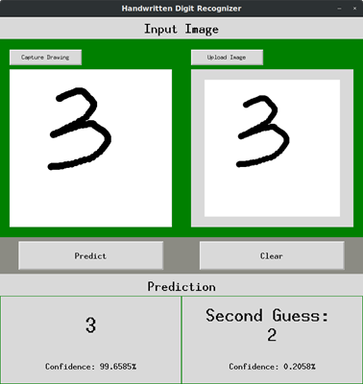
Conclusion: UI
Figure: UI Prediction of the uploaded image
Figure: UI Prediction of the User Drawn image​

Slide 23
Conclusion: Future Works
Extend the model to work on the NIST dataset.
Use CNN with less layers to get better accuracy.
More advanced techniques like Batch Normalization and Model Ensemble could be used.
Elastic Distortion could be used.
Regularization techniques like Drop Connect and activation functions like maxout could also be used

Slide 24
References
Y. Lecun, L. Bottou, Y. Bengio and P. Haffner, "Gradient-based learning applied to document recognition," in Proceedings of the IEEE, vol. 86, no. 11, pp. 2278-2324, Nov. 1998.
P. Y. Simard, D. Steinkraus and J. C. Platt, "Best practices for convolutional neural networks applied to visual document analysis," Seventh International Conference on Document Analysis and Recognition, 2003. Proceedings., Edinburgh, UK, 2003, pp. 958-963 .
G. E. Hinton, S. Osindero and Y. Teh, "A Fast Learning Algorithm for Deep Belief Nets," in Neural Computation, vol. 18, no. 7, pp. 1527-1554, July 2006.
D. C. Ciresan, U. Meier, L. M. Gambardella, J. Schmidhuber, “Deep Big Simple Neural Nets Excel on Handwritten Digit Recognition.” in Neural Computation, vol. 22, no. 12, pp. 3207–3220, Dec 2010.
D. Keysers, T. Deselaers, C. Gollan and H. Ney, "Deformation Models for Image Recognition," in IEEE Transactions on Pattern Analysis and Machine Intelligence, vol. 29, no. 8, pp. 1422-1435, Aug. 2007.
D. Decoste, B. Schölkopf, “Training Invariant Support Vector Machines,” Machine Learning, 46, 161–190, 2002.
D. Ciresan, U. Meier and J. Schmidhuber, "Multi-column deep neural networks for image classification," 2012 IEEE Conference on Computer Vision and Pattern Recognition, Providence, RI, 2012, pp. 3642-3649.
L. Wan, M. D. Zeiler, S. Zhang, Y. LeCun, R. Fergus, “Regularization of Neural Networks using DropConnect,” ICML, 2013.
And more…

Slide 25
Thank You

